Slide 1
ACTR
5
(Asteroid Composition Through Reflectance)

Slide 2
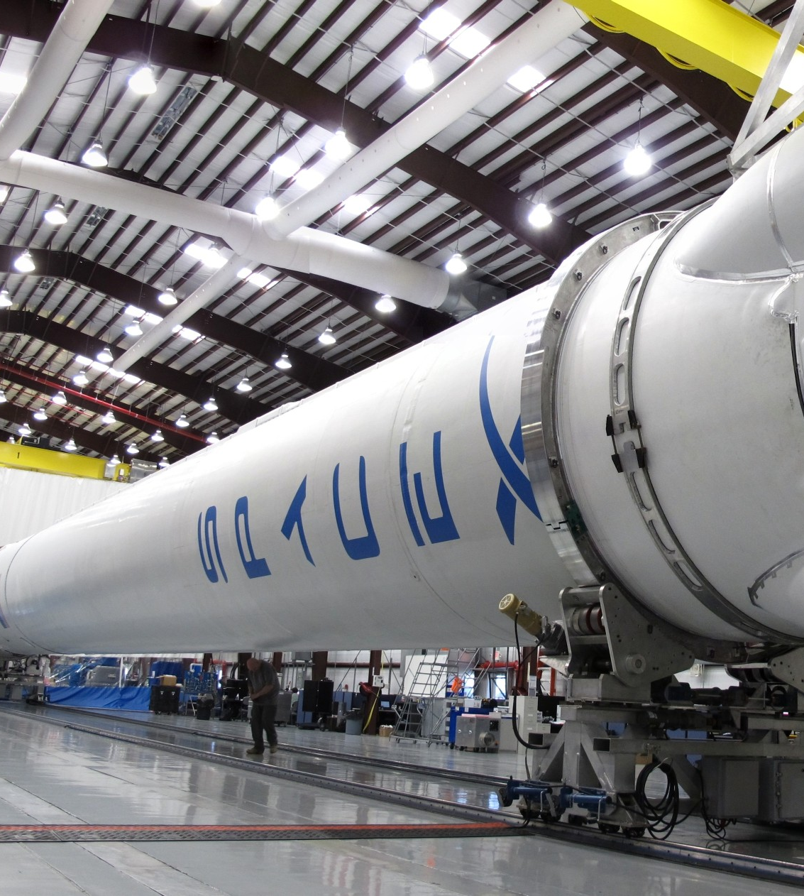
Problem
4
$2,100/kg Falcon 9
420,000 kg for ISS
$1.7 Billion

Slide 3
Impact
3
Economic - Earth mining economy and reduced mission cost
Technological - Enabling construction in space
Social - Reduced dependence on current sources for rare earth metals

Slide 4
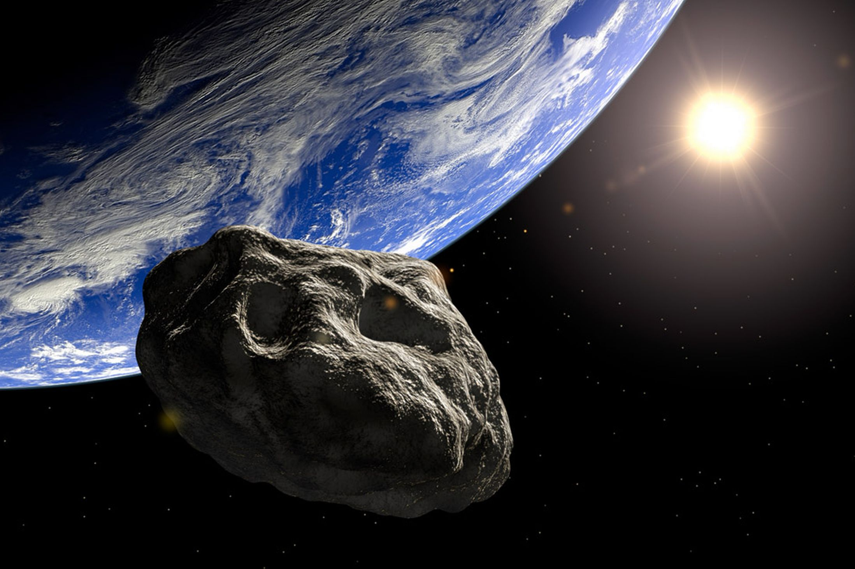
Background on Asteroids
2
Class M – Metallic
Class A – Olivine
Class C – Carbon, Silicates

Slide 5
Solution
1
Analyze the spectrometry data of reflected light
Match spectrum with classes
Improve model with future spectral data

Slide 6
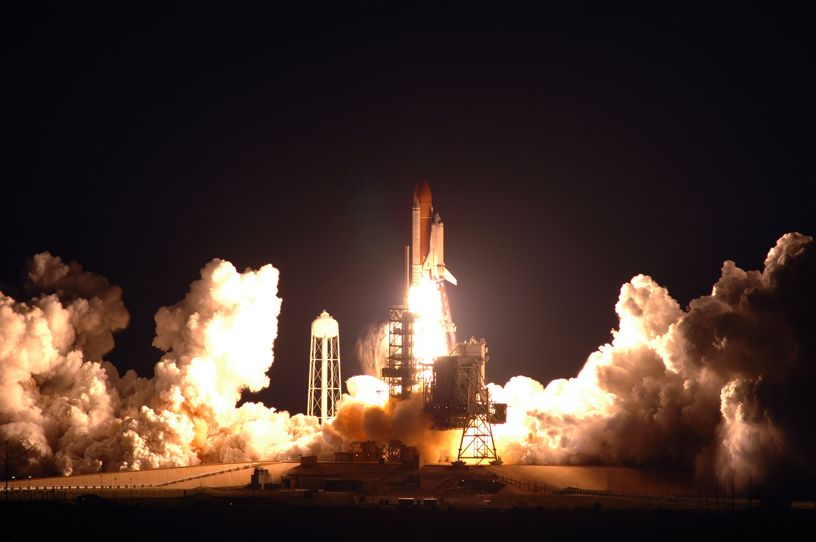
Demo

